Slide 1

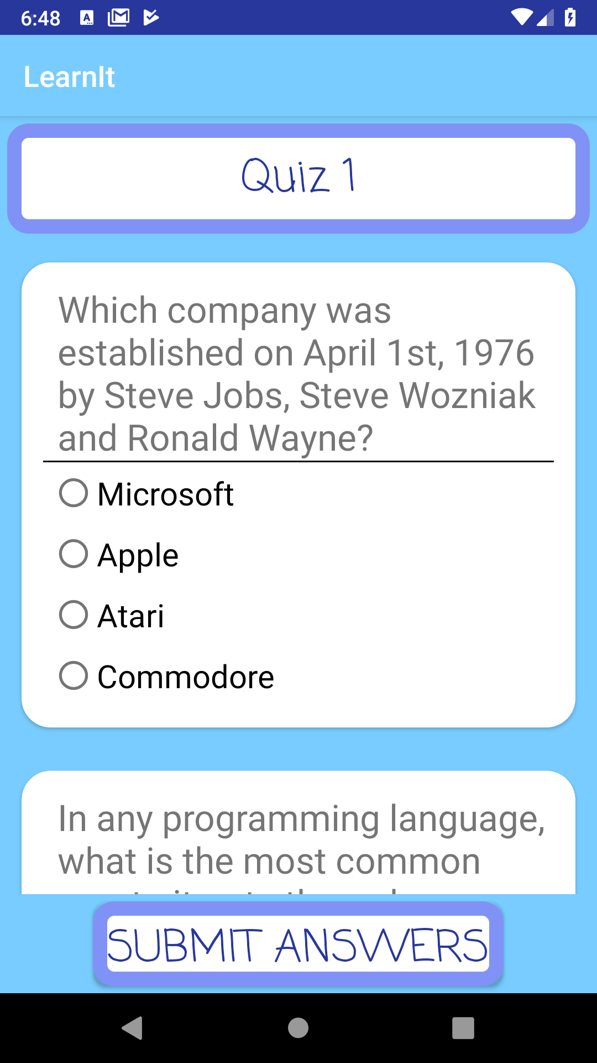
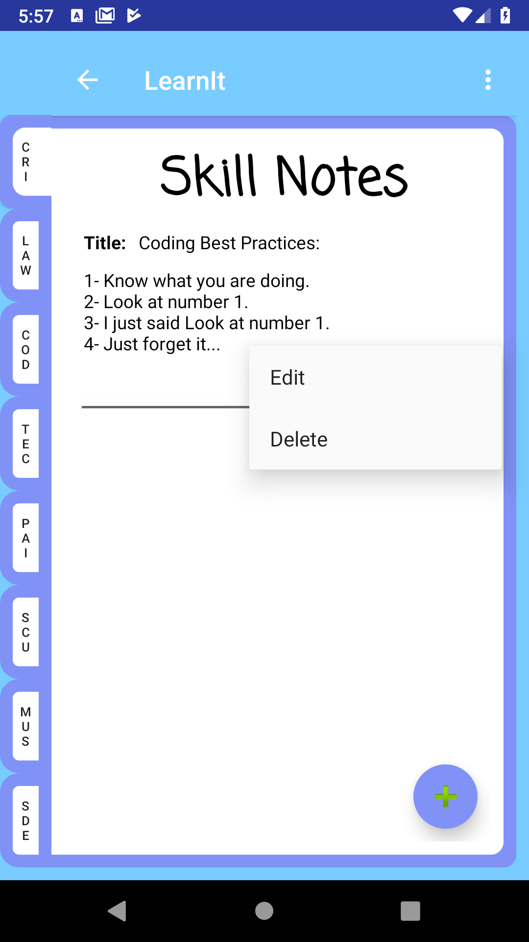
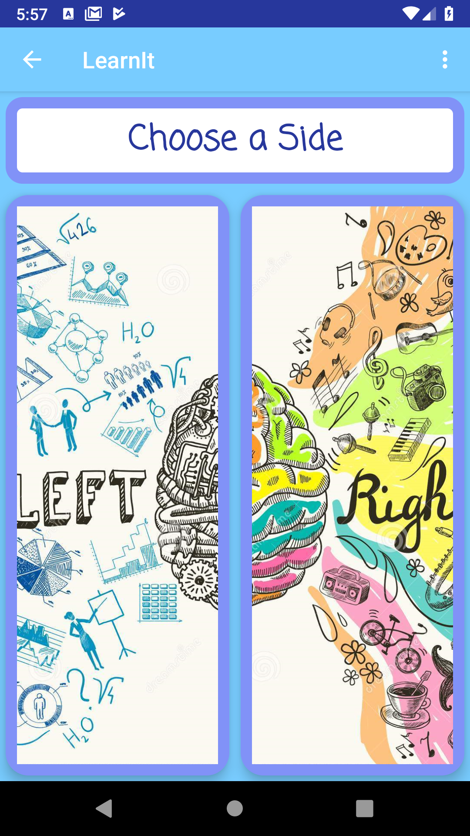
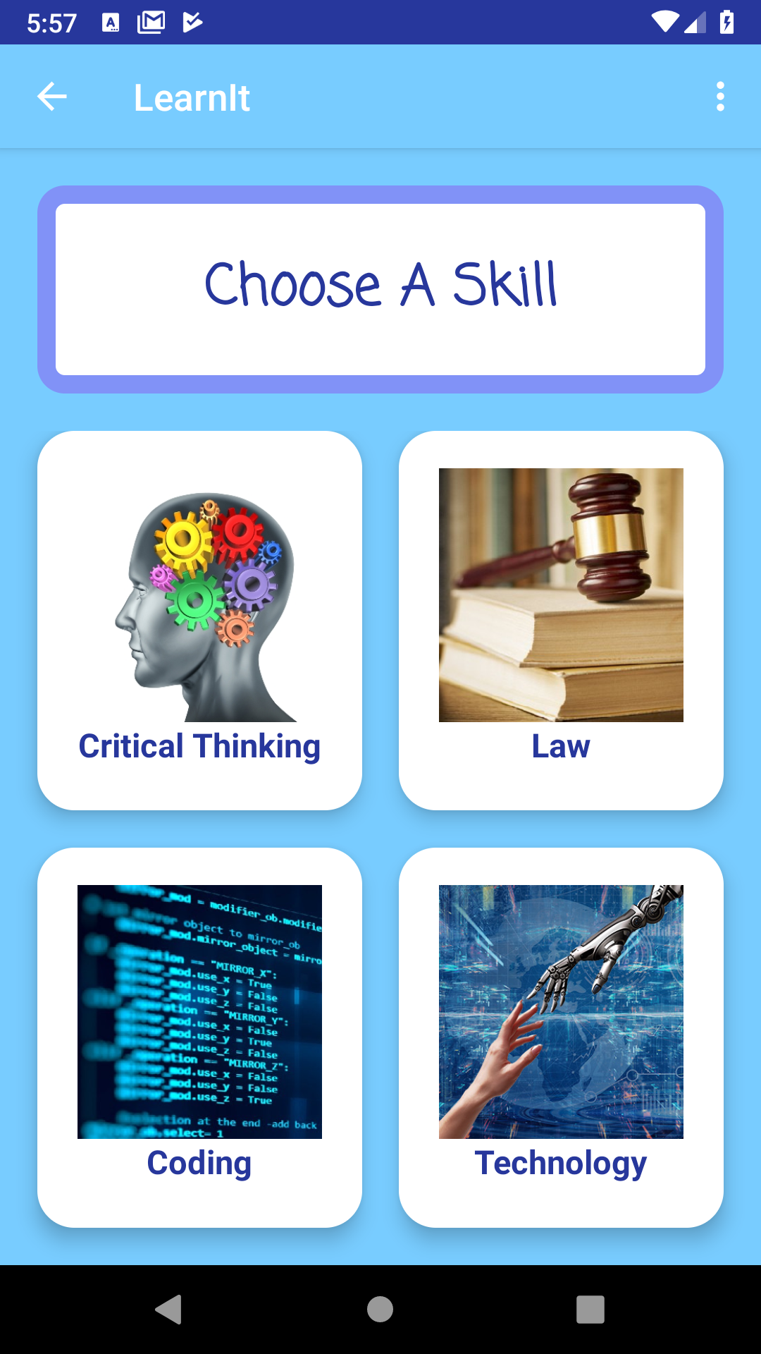
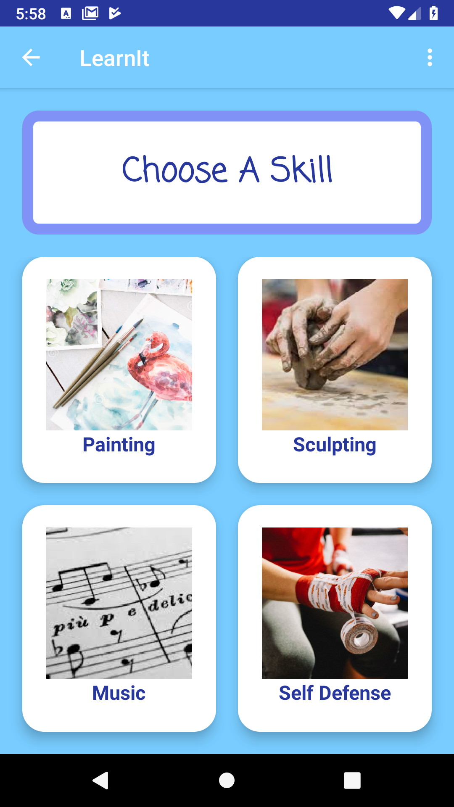
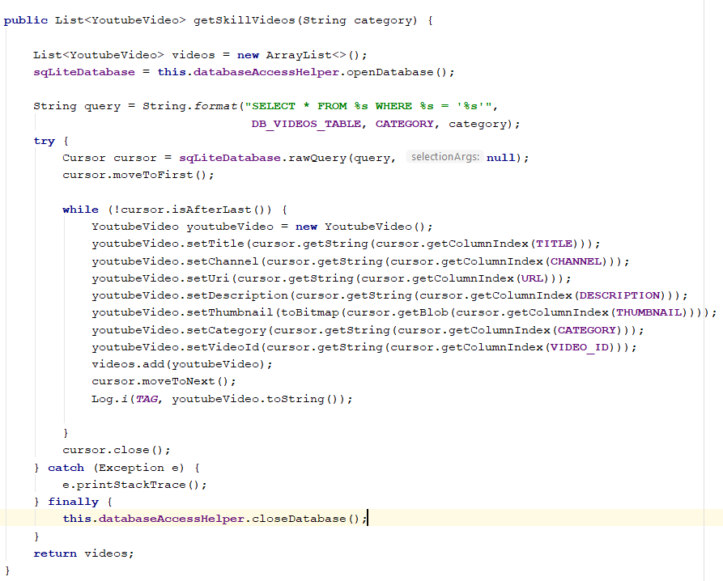
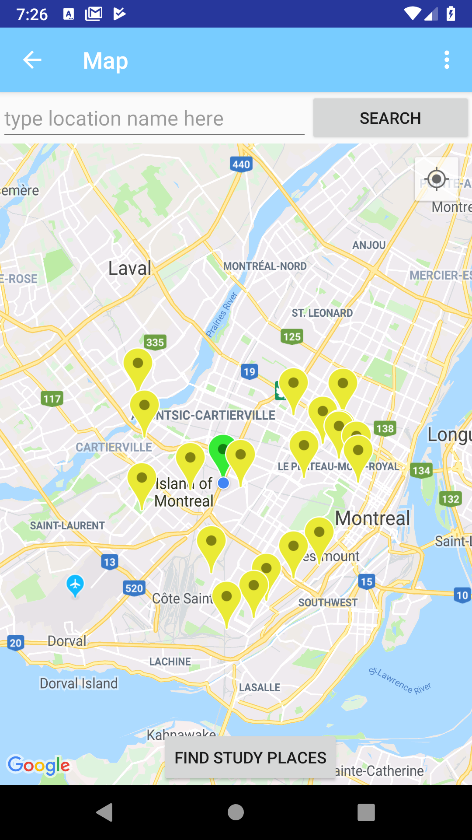
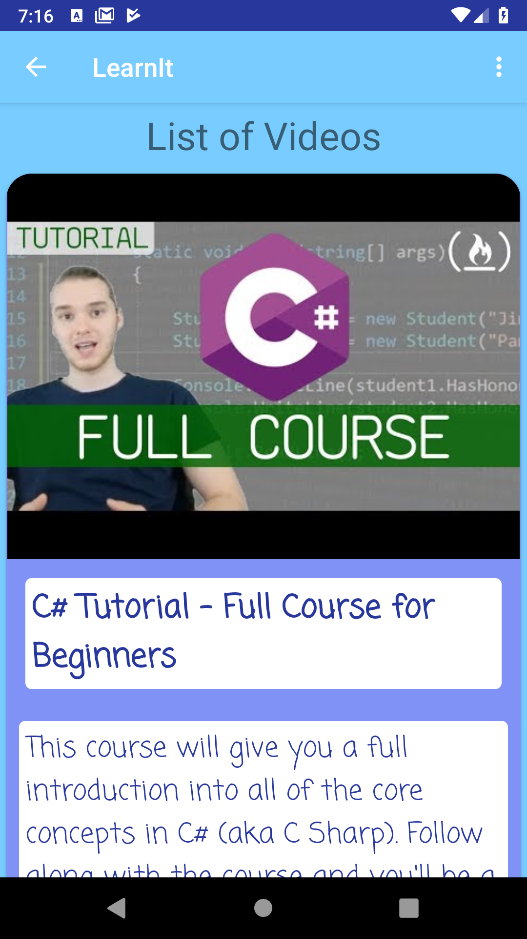
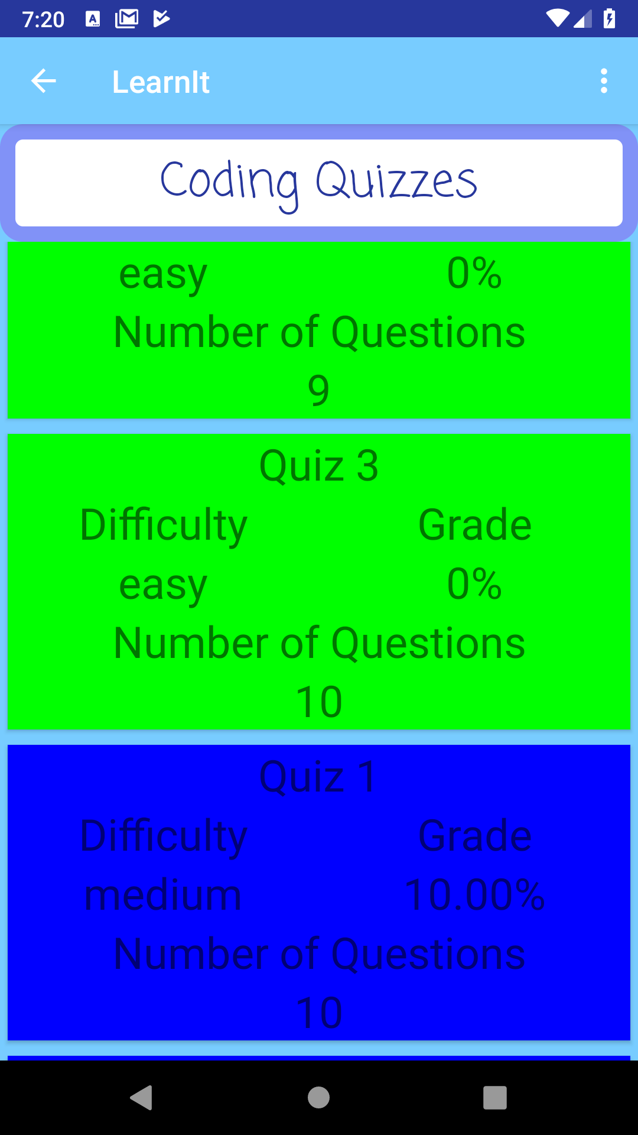
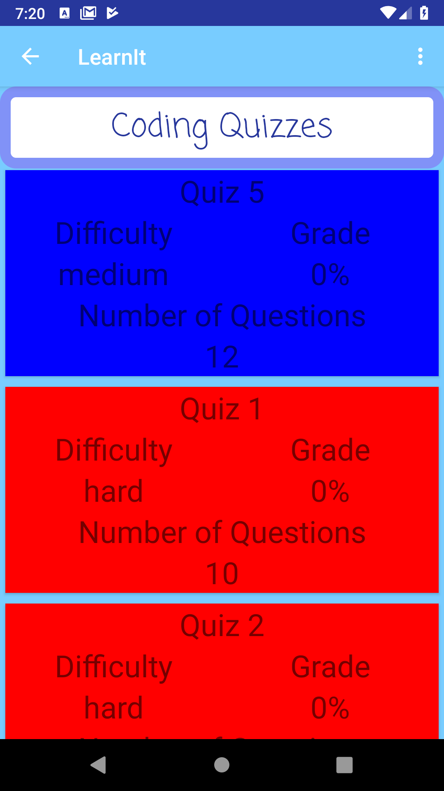
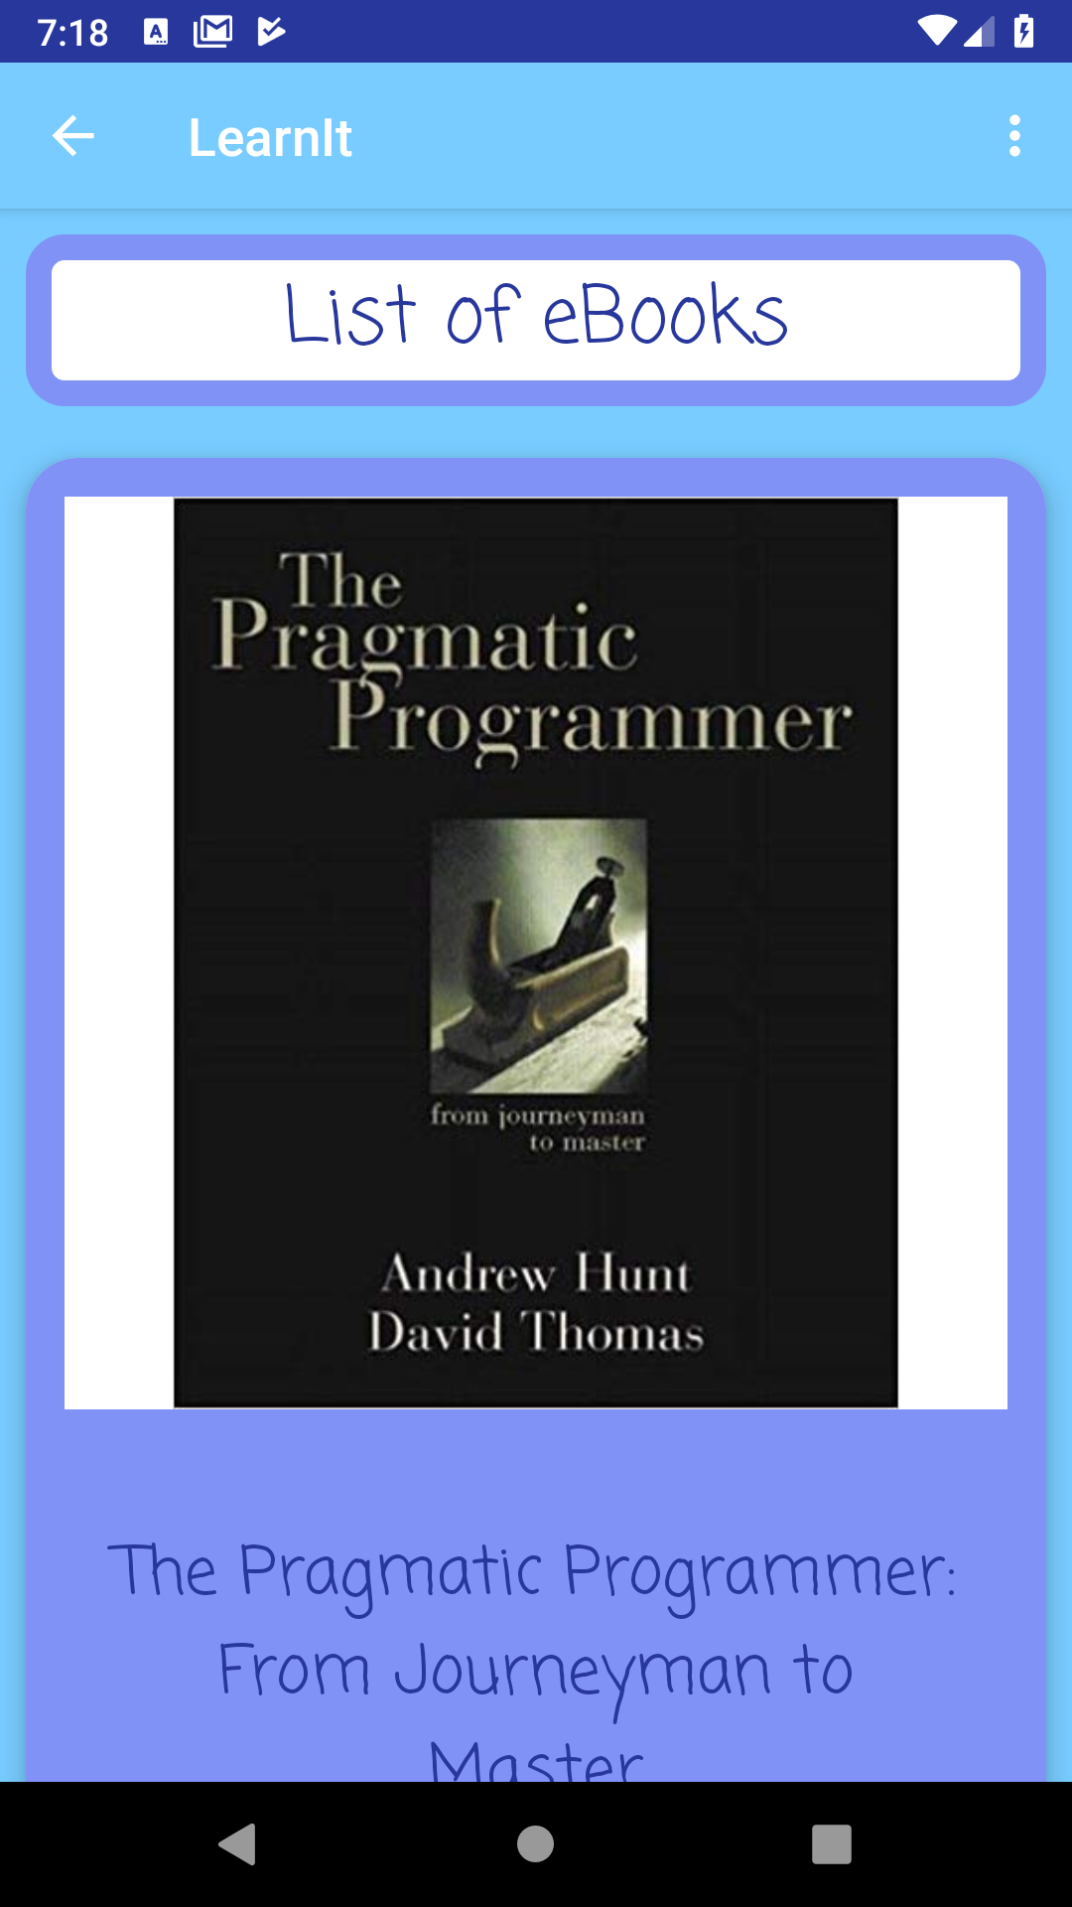
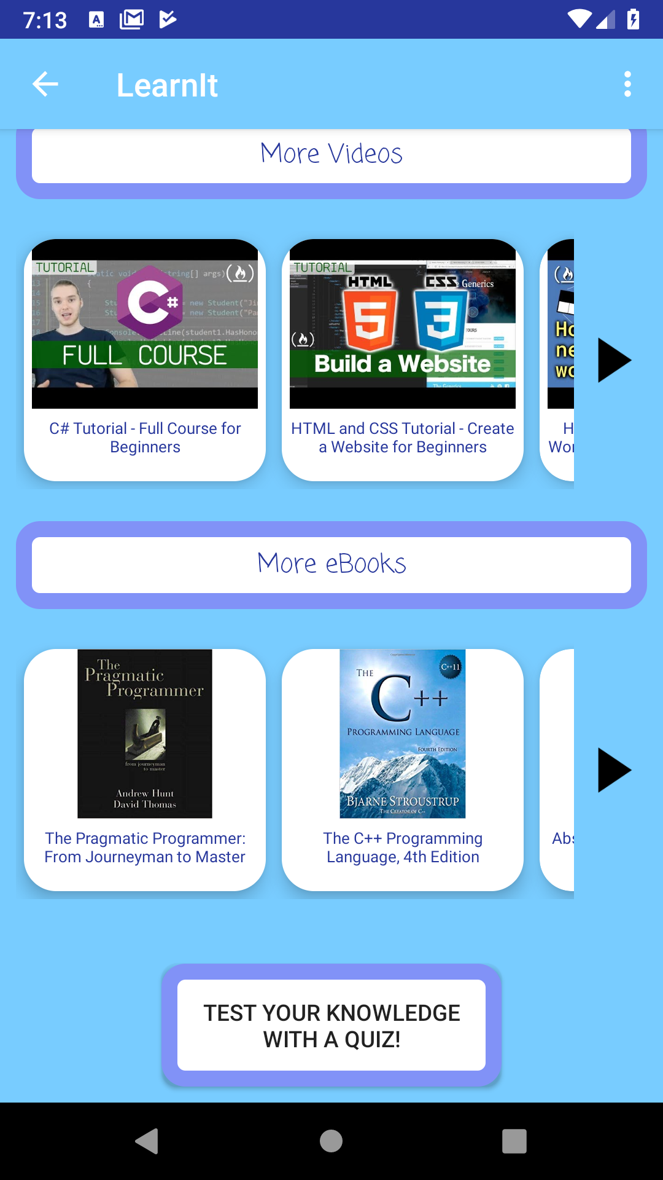
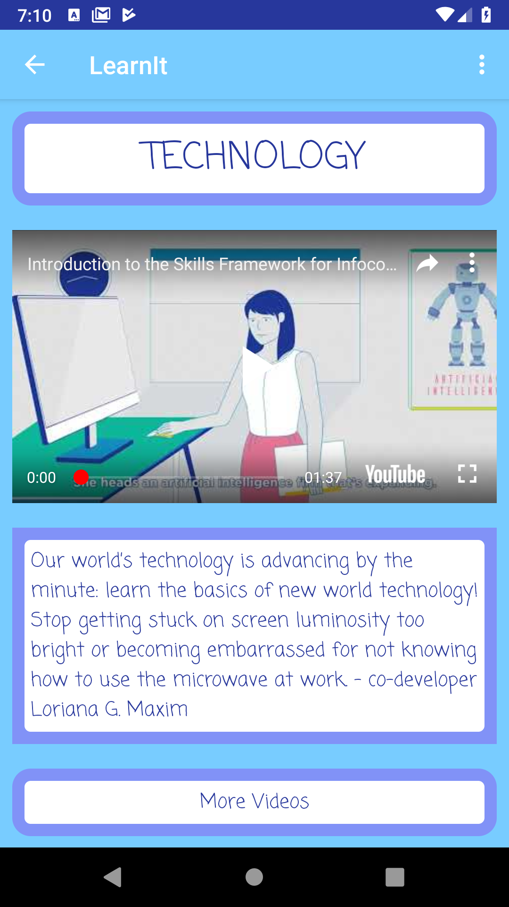
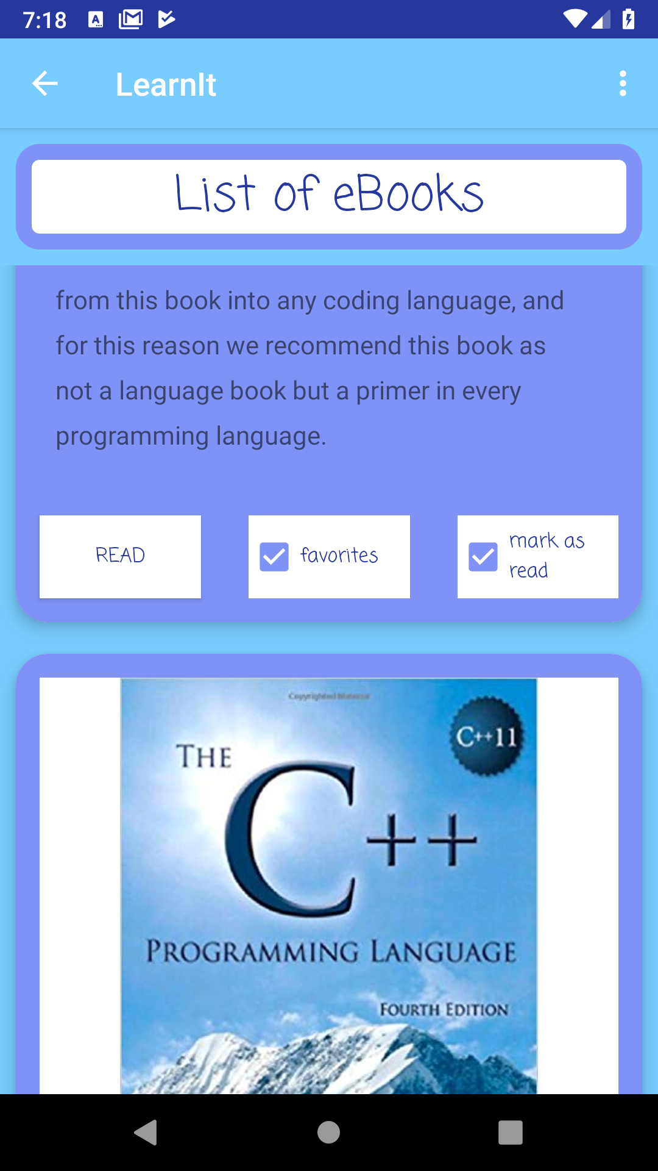
LearnIt
The App for Your Brain (or at least one half of it)
Learn to be Creative - Learn to be Logical - Learnit!
Karim Haddad, Loriana G. Maxim
As part of the 420-408-VA Graphical & Wireless Programming course – Winter 2019 Teacher: Sleiman Rabah, Computer Science Department
Designed and Implemented by
Project Description
LEARNIT is a learning application that facilitates knowledge acquirement about many subjects.
LearnIt provides you with a set of videos and eBooks to learn from, tests your knowledge related to the skills you are learning about, saves your notes about skill progress in an organized manner and shows you the location of the best places to study nearby.
APIs And Libraries Used
Google Maps API: Shows the map on the app.
Places API: Essential for the finding a study place.
Youtube API: Displays YouTube videos without leaving the app.
JSON: Reading data from the Trivia API.
Open Trivia: Provides quizzes based on category chosen.
SQLite database: Storing Urls of videos and eBooks for each skill.

